Slide 1
Boosting Algorithm
Dinesh C

Slide 2
AdaBoost (or) Adaptive Boosting Regressor
It is a powerful ensemble learning technique.
It combines multiple weak classifiers to create a strong classifier
It has 8 steps as below
Sample weight creation
Stump creation
Stump selection
Calculate total error
Calculate amount of say or Performance say
Update weight
Normalize the weights
New sample formation

Slide 3
Flowchart
Start
Initialize Sample Weight
Base Classifier Selection
Calculating Base Classifier Weights
Sample Weights Update
Reaching the iteration threshold
No
Yes
Obtain the Final Model
End

Slide 4
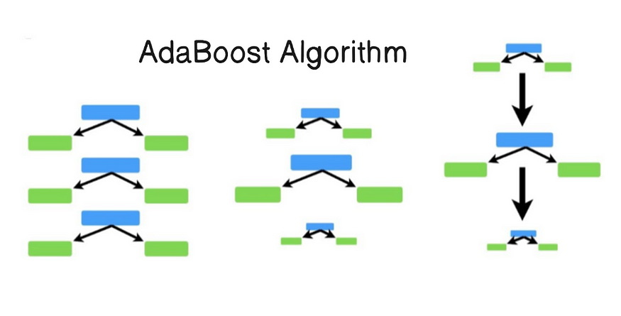
Root node with leaf node in only one depth is know as STUMPS
Calculate the Entropy for each stump and select the stump which has minimum Entropy value

Slide 5
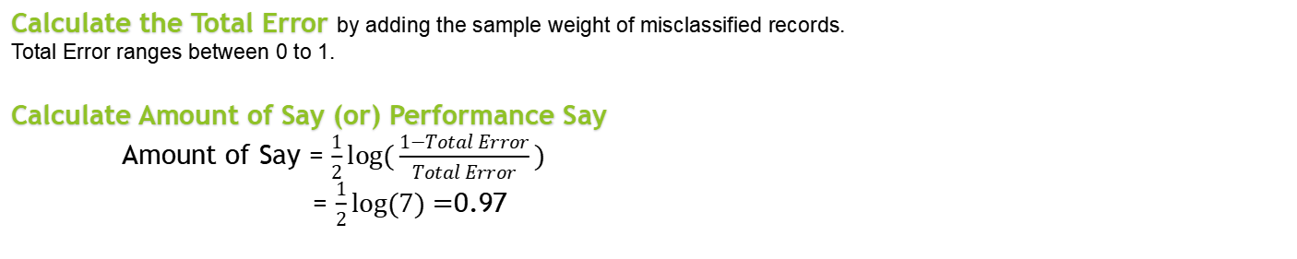
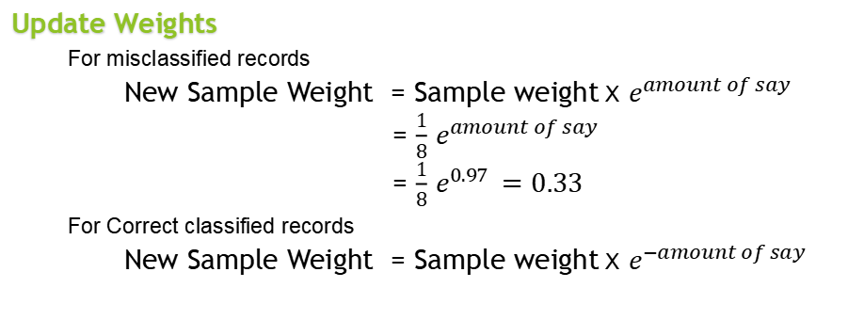
Calculate the Total Error by adding the sample weight of misclassified records.
Total Error ranges between 0 to 1.
Calculate Amount of Say (or) Performance Say
Amount of Say = $\frac{1}{2}log⁡(\frac{1−Total Error}{Total Error})$
= $\frac{1}{2}log⁡(7)=$0.97
Update Weights
For misclassified records
New Sample Weight = Sample weight X $e^{amount of say}$
= $\frac{1}{8}$ $e^{amount of say}$
= $\frac{1}{8}$ $e^{0.97 }=0.33$
For Correct classified records
New Sample Weight = Sample weight X $e^{−amount of say}$
F1 | F2 | F3 | Output |  | Sample Weight |  | Updated Weights
12 | 3 | 23 | Yes |  | 1/8 |  | 0.05
23 | 5 | 45 | Yes |  | 1/8 |  | 0.05
34 | 3 | 43 | No |  | 1/8 |  | 0.05
21 | 4 | 65 | Yes |  | 1/8 |  | 0.33
45 | 5 | 34 | No |  | 1/8 |  | 0.05
12 | 2 | 23 | No |  | 1/8 |  | 0.05
34 | 5 | 43 | Yes |  | 1/8 |  | 0.05
16 | 6 | 45 | Yes |  | 1/8 |  | 0.05

Slide 6
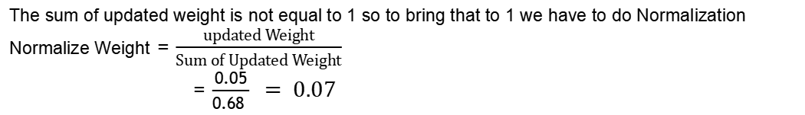
Normalize Weight
The sum of updated weight is not equal to 1 so to bring that to 1 we have to do Normalization
Normalize Weight = $\frac{updated Weight}{Sum of Updated Weight}$
= $\frac{0.05}{0.68 } = 0.07$
F1 | F2 | F3 | Output |  | Sample Weight |  | Updated Weights |  | Normalized Weight
12 | 3 | 23 | Yes |  | 1/8 |  | 0.05 |  | 0.07
23 | 5 | 45 | Yes |  | 1/8 |  | 0.05 |  | 0.07
34 | 3 | 43 | No |  | 1/8 |  | 0.05 |  | 0.07
21 | 4 | 65 | Yes |  | 1/8 |  | 0.33 |  | 0.49
45 | 5 | 34 | No |  | 1/8 |  | 0.05 |  | 0.07
12 | 2 | 23 | No |  | 1/8 |  | 0.05 |  | 0.07
34 | 5 | 43 | Yes |  | 1/8 |  | 0.05 |  | 0.07
16 | 6 | 45 | Yes |  | 1/8 |  | 0.05 |  | 0.07
New sample formation
To get new random samples it will reorder based on bucket values and frame new dataset
After sample formation it starts from step 2
F1 | F2 | F3 | Output |  | Sample Weight |  | Buckets |  | F1 | F2 | F3 | Output |  | Sample Weight
12 | 3 | 23 | Yes |  | 0.07 |  | 0 - 0.07 |  | 34 | 3 | 43 | No |  | 0.07
23 | 5 | 45 | Yes |  | 0.07 |  | 0.07 - 0.14 |  | 23 | 5 | 45 | Yes |  | 0.07
34 | 3 | 43 | No |  | 0.07 |  | 0.14 - 0.21 |  | 12 | 3 | 23 | Yes |  | 0.07
21 | 4 | 65 | Yes |  | 0.49 |  | 0.21 - 0.70 |  | 34 | 5 | 43 | Yes |  | 0.07
45 | 5 | 34 | No |  | 0.07 |  | 0.70 - 0.77 |  | 16 | 6 | 45 | Yes |  | 0.07
12 | 2 | 23 | No |  | 0.07 |  | 0.77 - 0.84 |  | 12 | 2 | 23 | No |  | 0.07
34 | 5 | 43 | Yes |  | 0.07 |  | 0.84 - 0.93 |  | 45 | 5 | 34 | No |  | 0.07
16 | 6 | 45 | Yes |  | 0.07 |  | 0.93 - 1 |  | 21 | 4 | 65 | Yes |  | 0.49

Slide 7
XG Boosting
Extreme Gradient Boosting
Ref : https://www.youtube.com/watch?v=w-_vmVfpssg

Slide 8
XgBoost Regressor
It is a powerful supervised machine learning algorithm.
It is designed to optimize performance and computational speed
It has 5 steps as below
Residual calculation
Similarity Weight
Information Gain
Output calculation
Calculate next Residual based on new output

Slide 9
Flowchart
Start
Residual Calculation
Similarity Weight
Information Gain
No
Output calculation
Reaching the iteration threshold
Yes
Obtain the Final Model
End

Slide 10

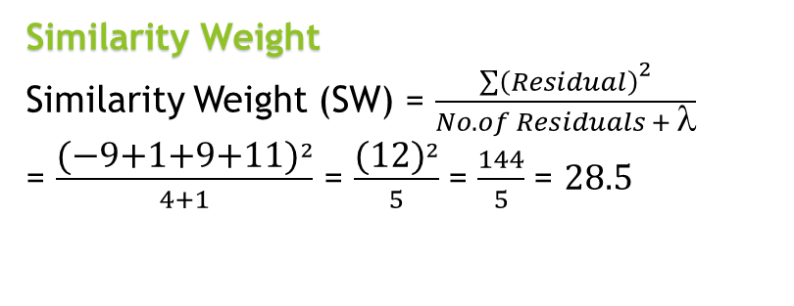
Residual = Output - Average of Output
Experience | Gap | Salary |  | Residual
2 | Yes | 40 | (40-51) = | -11
2.5 | Yes | 42 |  | -9
3 | No | 52 |  | 1
4 | No | 60 |  | 9
4.5 | Yes | 62 |  | 11
 | Sum | 256
 | Average | 51
Similarity Weight
Similarity Weight (SW) = $\frac{{\sum{\left(Residual\right)}}^{2}}{No. of Residuals + λ}$
= $\frac{{\text{(−9+1+9+11)}}^{2}}{4+1}$ = $\frac{{\text{(12)}}^{2}}{5}$ = $\frac{144}{5}$ = $28.5$
[Experience]
-11,-9,1,9,11
SW = 0.16
<=2
>2
-11
-9,1,9,11
SW = 65.5
$Consider $ = 1
SW = 28.5
Information Gain
= ∑ leaf SW – Root SW = 65.5 + 28.5 – 0.16 = 93.84
Identify the Gain for each row and select the max Gain tree.
After Identifying that go with next feature e.g Gap

Slide 11
[Experience]
-11,-9,1,9,11
<=2.5
>2.5
-11,-9
1,9,11
Avg. = -10
Yes
No
11
1,9
Avg. = 11
Avg. = 5
Output calculation
= Avg. of Base o/p + [Learning Parameter (α1) × T1]+ [α2 × T2] + [α3 × T3] + …
Consider Learning Parameter is 0.5
= 51 + (0.5 × -10) = 51 – 5 = 46
Experience | Gap | Salary (O/P) |  | Residual |  | New Output
2 | Yes | 40 | (40-51.2) = | -11 |  | 46
2.5 | Yes | 42 |  | -9 |  | 46
3 | No | 52 |  | 1 |  | 53.5
4 | No | 60 |  | 9 |  | 62
4.5 | Yes | 62 |  | 11 |  | 63
 | Sum | 256
 | Average | 51.2

Slide 12
LG Boosting
Light Gradient Boosting
Ref : https://www.youtube.com/watch?v=w-_vmVfpssg

Slide 13
LightGBM is a gradient boosting framework that uses tree-based learning algorithms. It is designed to be distributed and efficient with the following advantages
Faster training speed and higher efficiency.
Lower memory usage.
Better accuracy.
Support of parallel, distributed, and GPU learning.
Capable of handling large-scale data.

Slide 14
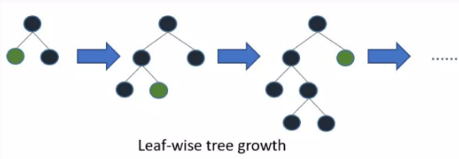
LG Boosting Growth

Slide 15
1. Converts the data into Histogram data, i.e split the data and brings it under few category
Exclusive Feature Bundling
 | 50,55,59,60,64,69,70
50 - 60 |  | 60 - 70
Male | Female |  | EFB
1 | 0 |  | 11
1 | 0 |  | 11
0 | 1 |  | 10
1 | 0 |  | 11
0 | 1 |  | 10

Slide 16
Gradient-based One Side Sampling(GOSS)
It is used for sampling the dataset
Data points with greater gradients are given more weight when computing gain by GOSS
To maintain accuracy, data points with smaller gradients are arbitrarily deleted while some are kept.
Given the same sampling rate as random sampling, this approach is often superior.

